Slide 1
The Rod Theory
By JunAng Wang
2023/10/13

Slide 2
Recap
Laws of physics
Integration in time
Integration in space

Slide 3
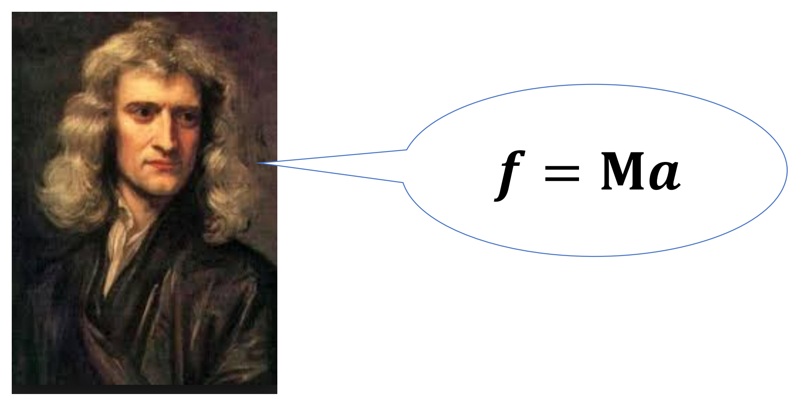
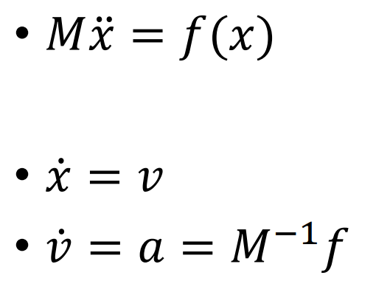
Recap
Laws of physics

Slide 4
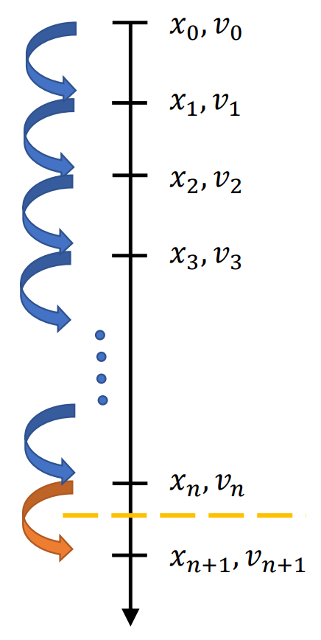
Recap
Laws of physics

Slide 5
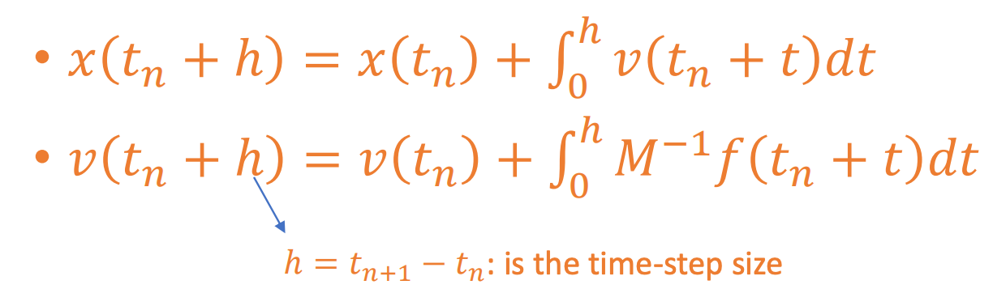
Recap
Laws of physics

Slide 6
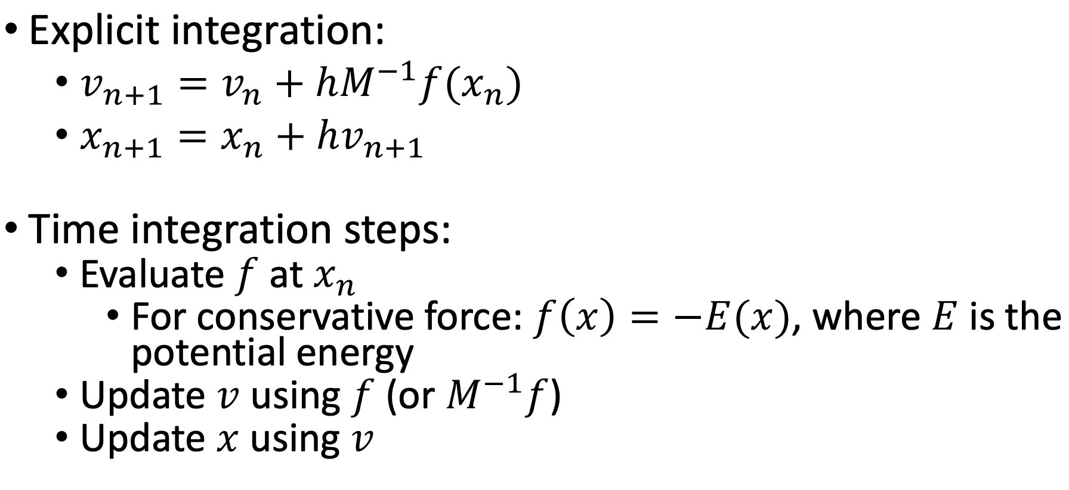

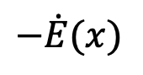
Time Integration in Practice
$$−\dot{E}(x)$$

Slide 7
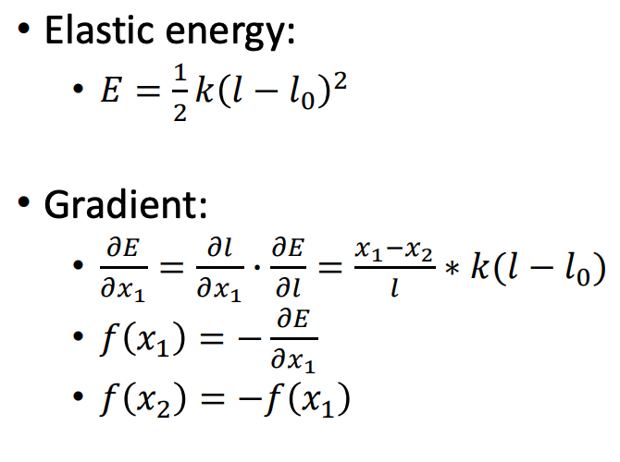
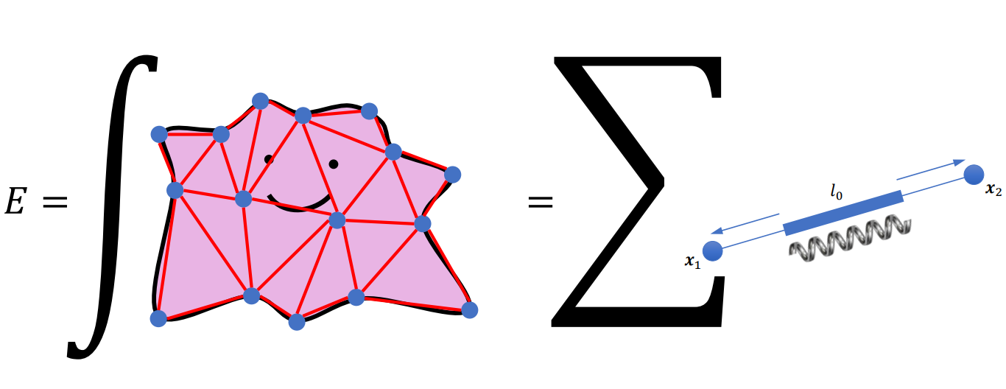
Mass-spring system

Slide 8
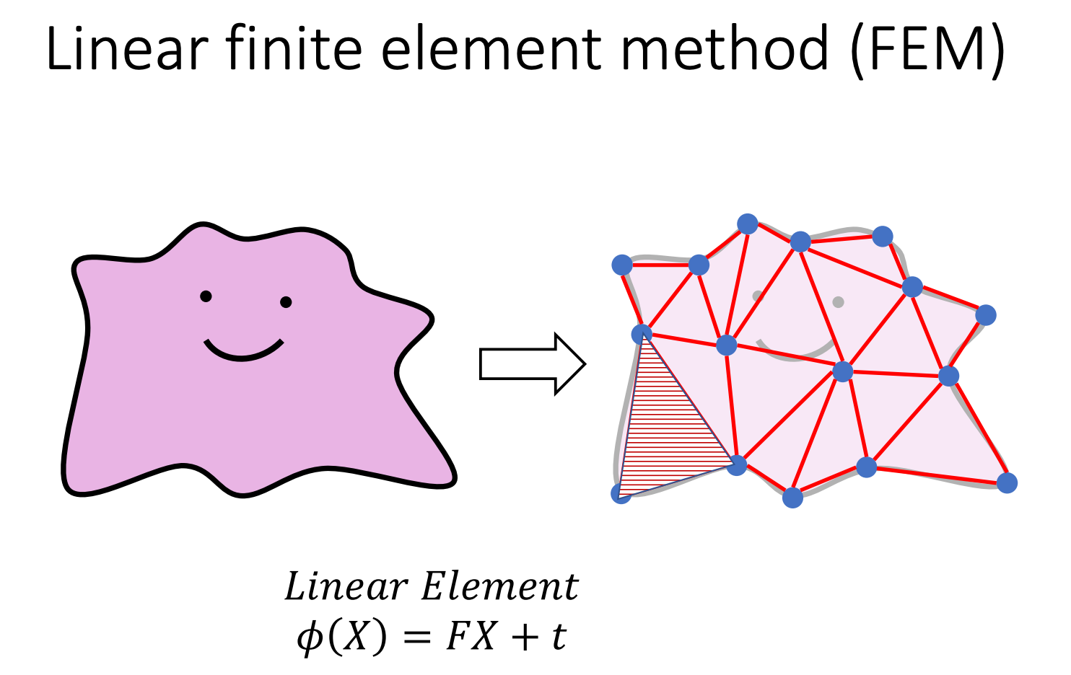

Slide 9
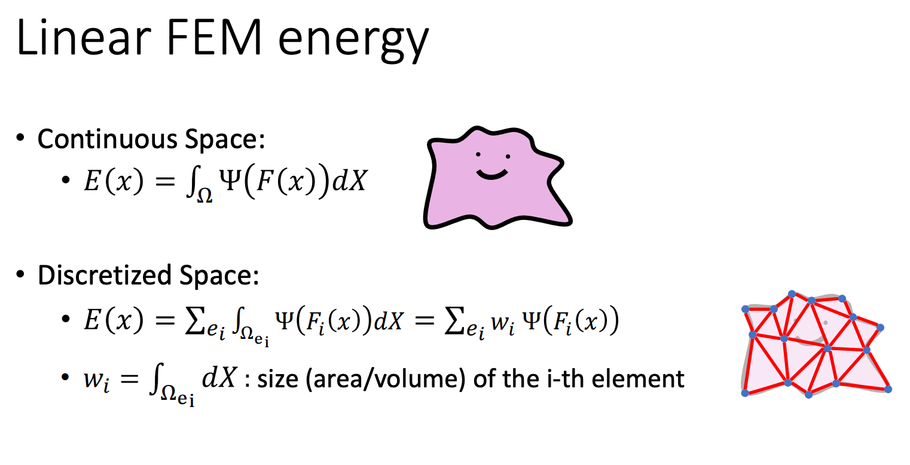

Slide 10
How PyElastica works?

Slide 11
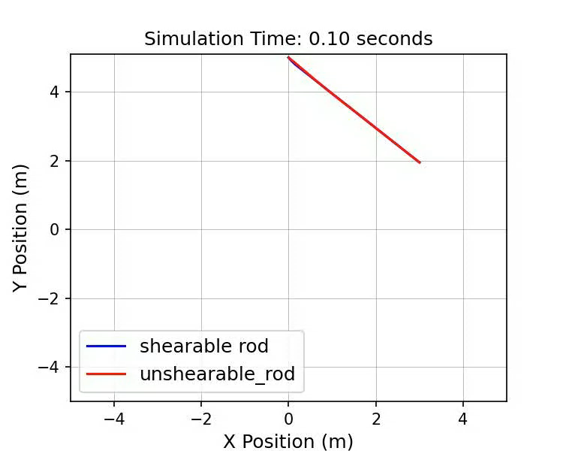
How PyElastica works?

Slide 12
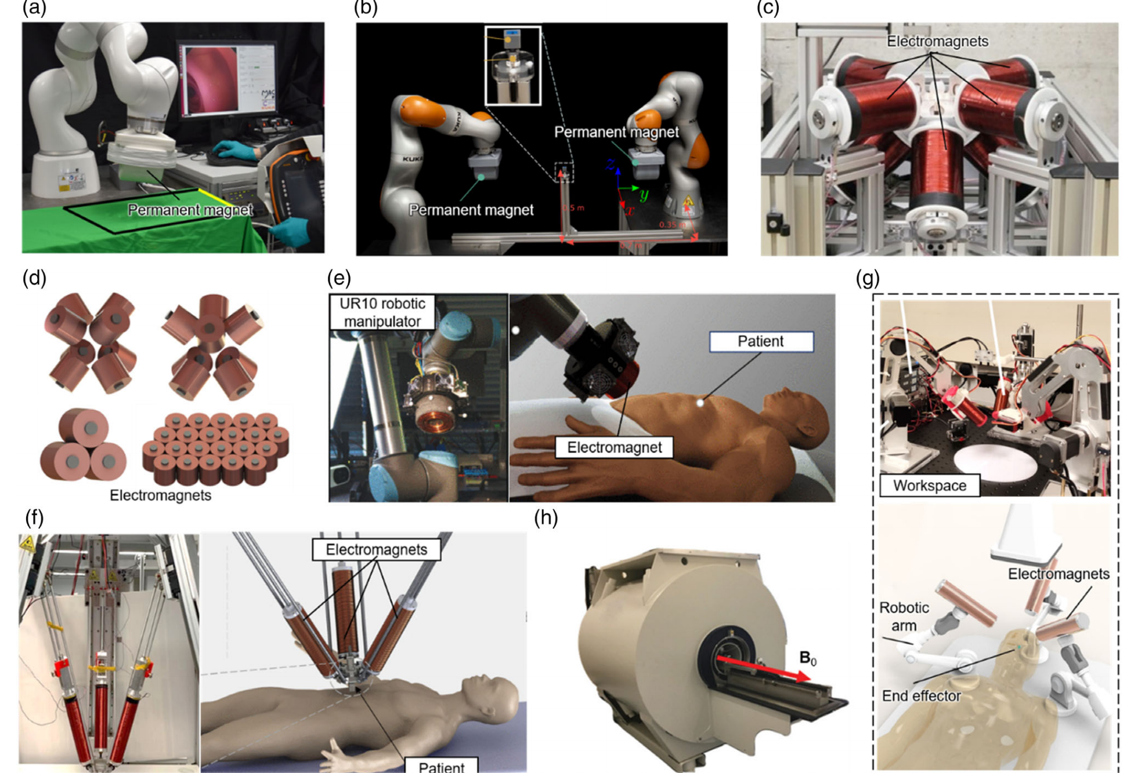
What we are studying at?
Yang, Z., Yang, H., Cao, Y., Cui, Y., & Zhang, L. (2023).

Slide 13
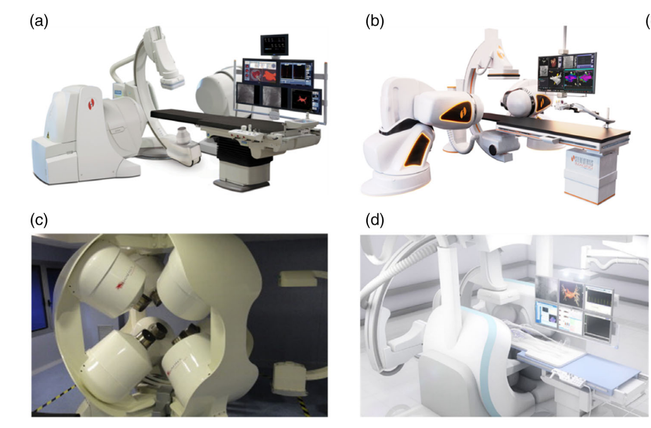
What we are studying at?
Yang, Z., Yang, H., Cao, Y., Cui, Y., & Zhang, L. (2023).

Slide 14
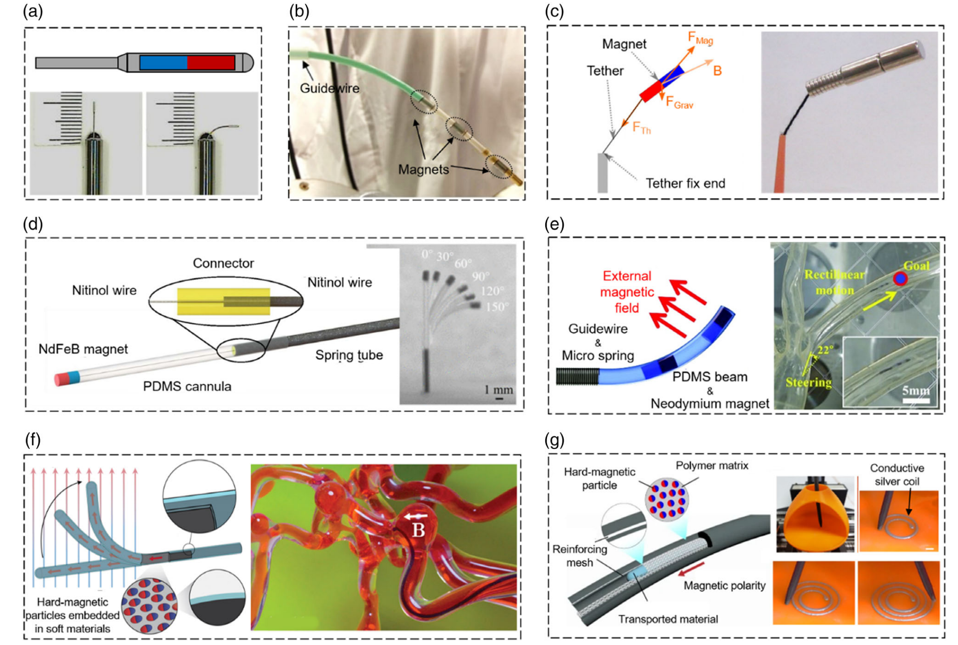
What we are studying at?
Yang, Z., Yang, H., Cao, Y., Cui, Y., & Zhang, L. (2023).

Slide 15
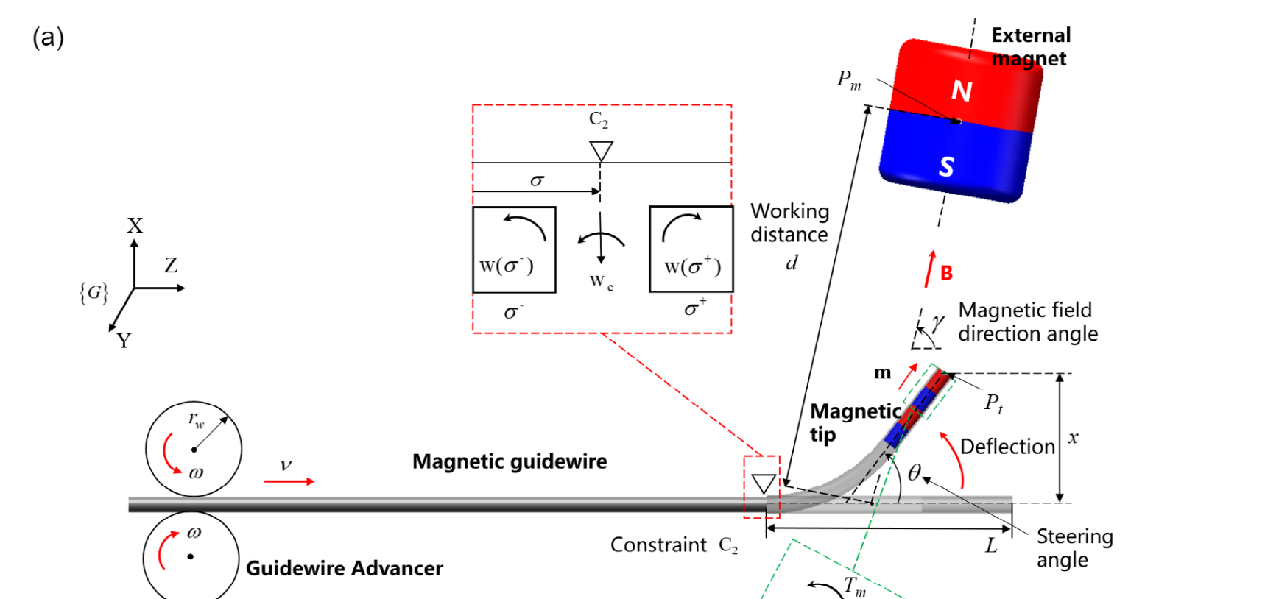
What we are studying at?
Fu, S., Xu, T. et al. 2023

Slide 16
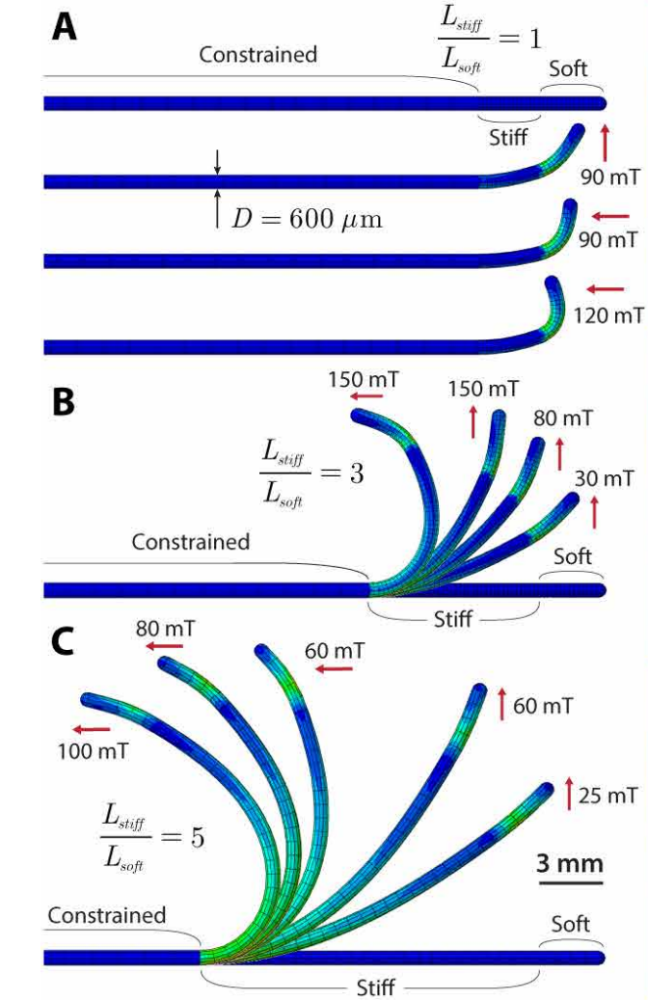
What we are studying at?
Yoonho Kimet al. 2019

Slide 17
Outline
Three dimensional continua and one dimensional continua
The Lagrange coordinate
Mechanics of a Rod
Outlook

Slide 18
3D continua and 1D continua

Slide 19
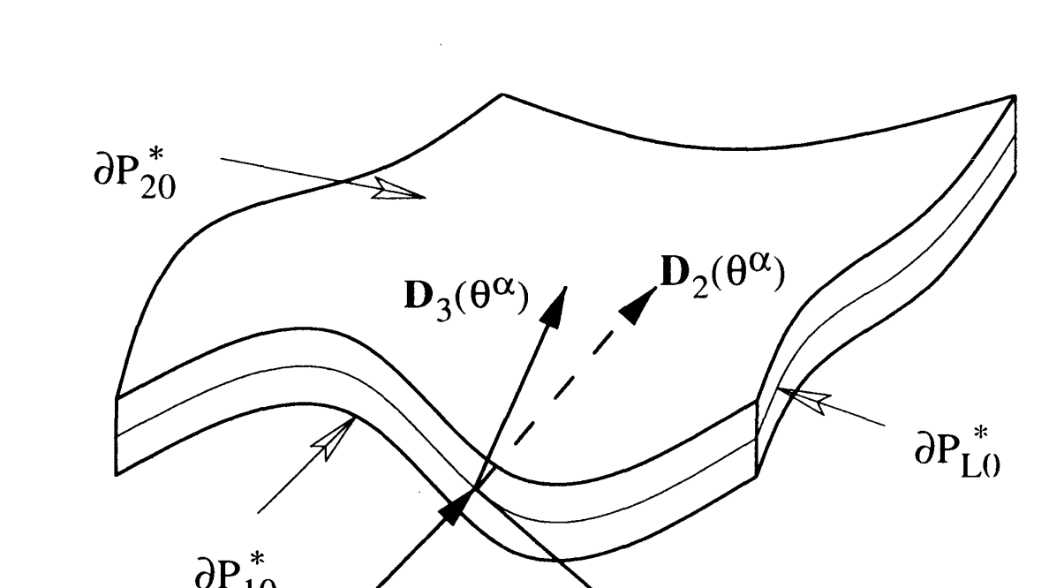
3D continua and 1D continua
M. B. Rubin, Cosserat Theories: Shells, Rods and Points

Slide 20
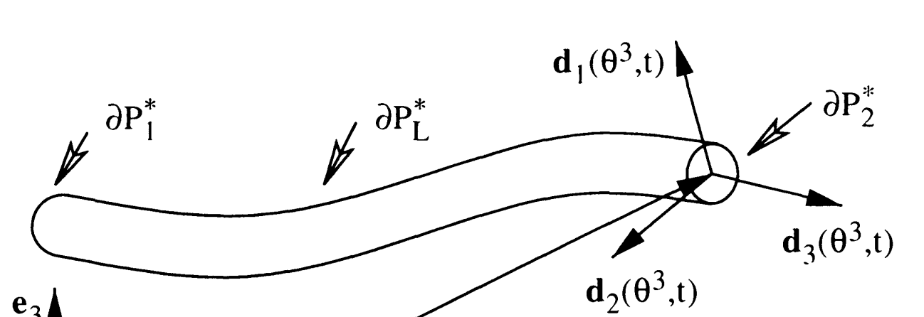
3D continua and 1D continua
M. B. Rubin, Cosserat Theories: Shells, Rods and Points

Slide 21
3D continua and 1D continua
M. B. Rubin, Cosserat Theories: Shells, Rods and Points

Slide 22
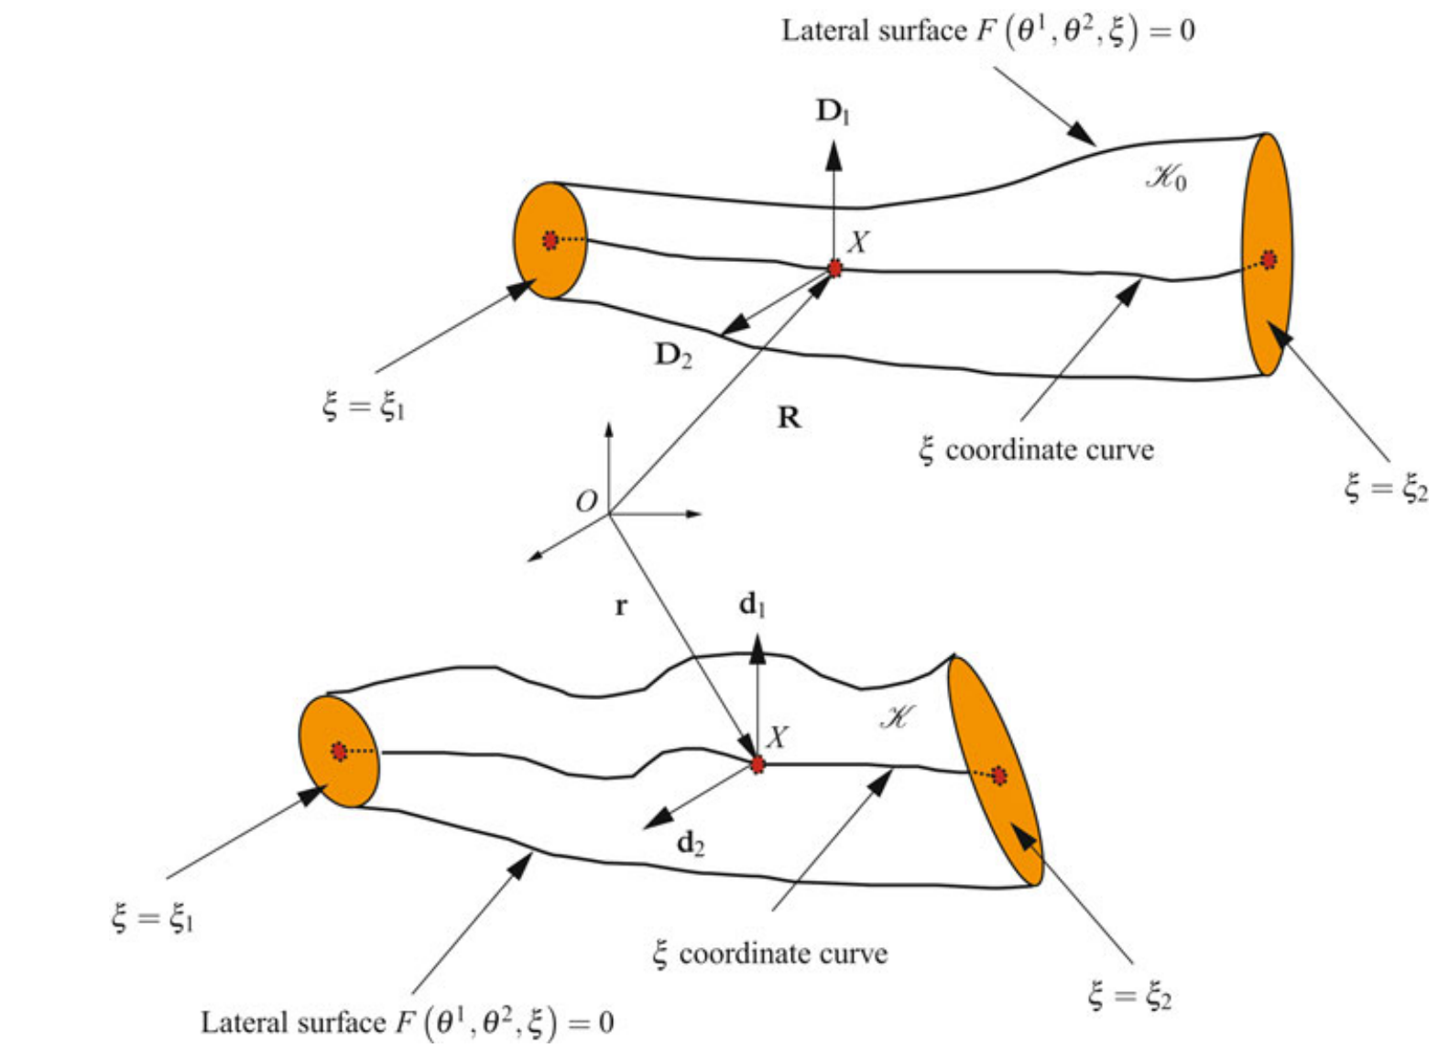
3D continua and 1D continua
M. B. Rubin, Cosserat Theories: Shells, Rods and Points

Slide 23
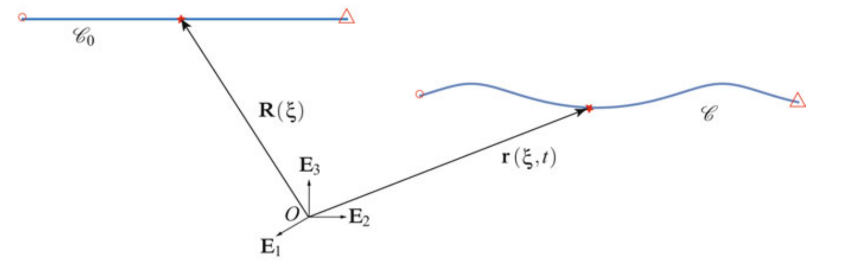
The Lagrange coordinate
M. B. Rubin, Cosserat Theories: Shells, Rods and Points

Slide 24
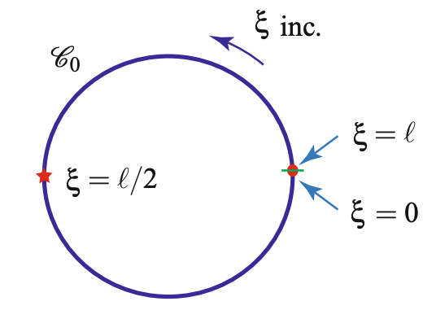
The Lagrange coordinate
M. B. Rubin, Cosserat Theories: Shells, Rods and Points

Slide 25
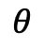
The Lagrange coordinate
$$θ$$
M. B. Rubin, Cosserat Theories: Shells, Rods and Points

Slide 26
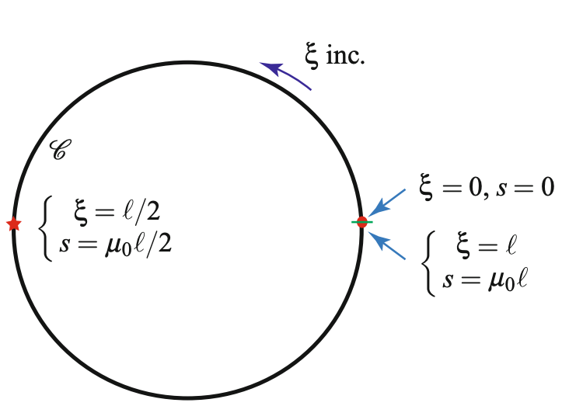
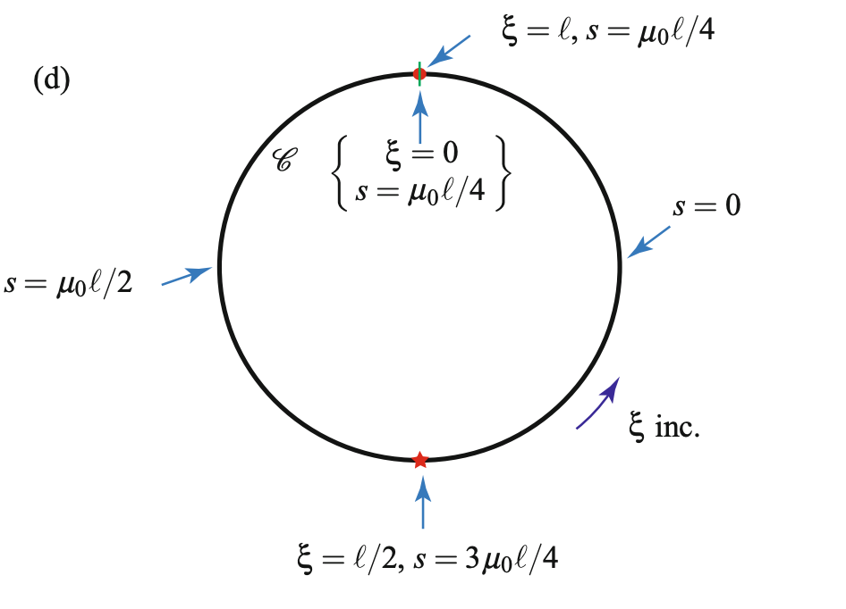
The Lagrange coordinate
M. B. Rubin, Cosserat Theories: Shells, Rods and Points

Slide 27
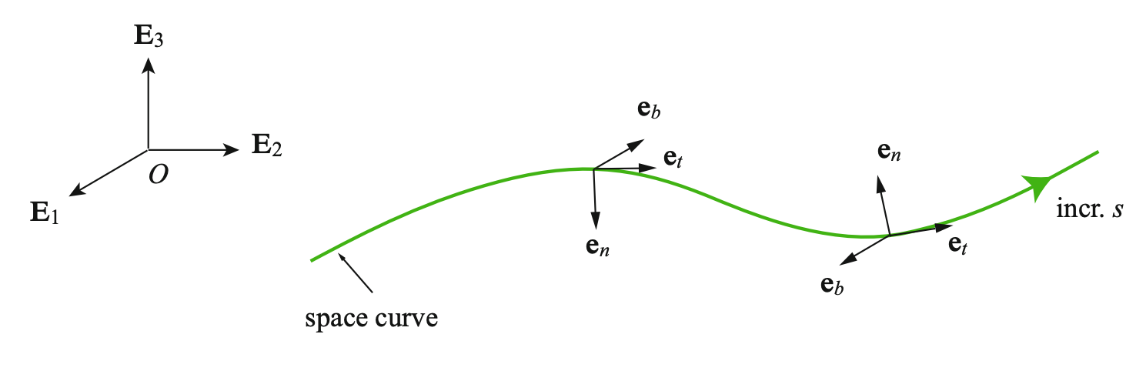
The Lagrange coordinate
M. B. Rubin, Cosserat Theories: Shells, Rods and Points

Slide 28
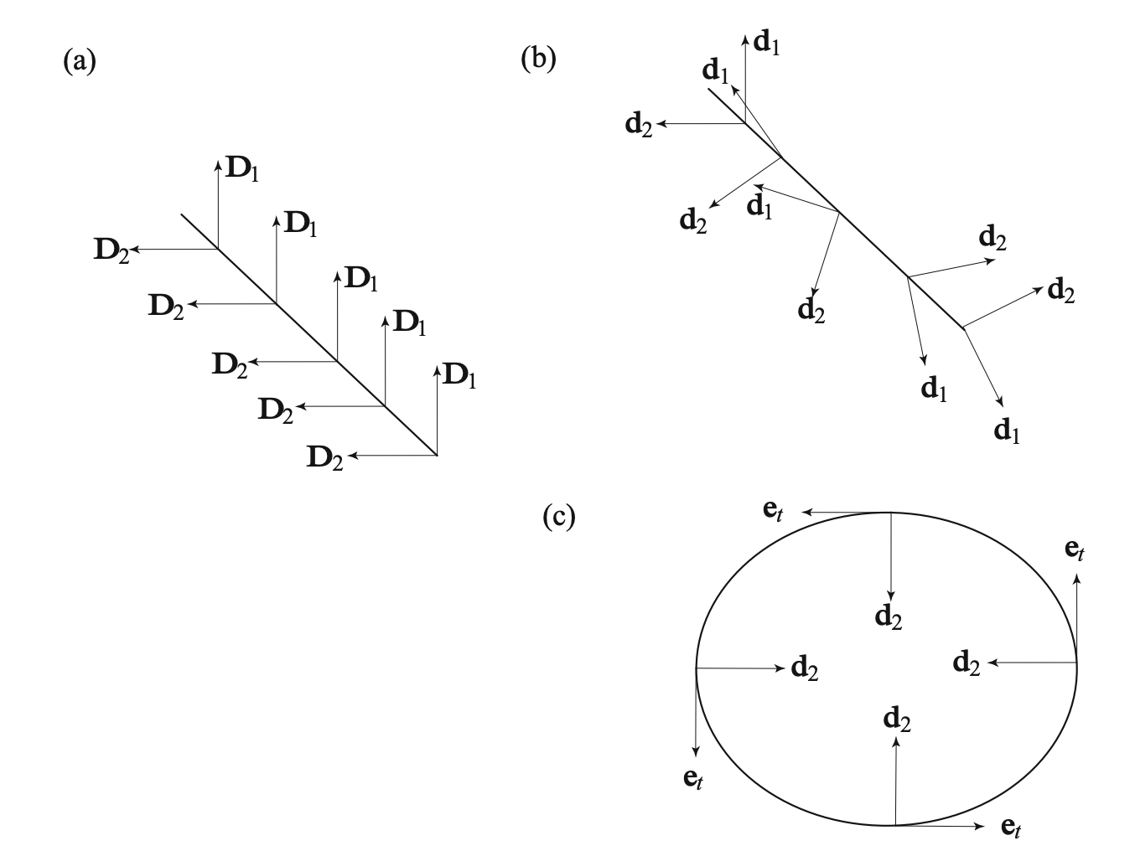
The Lagrange coordinate
M. B. Rubin, Cosserat Theories: Shells, Rods and Points

Slide 29
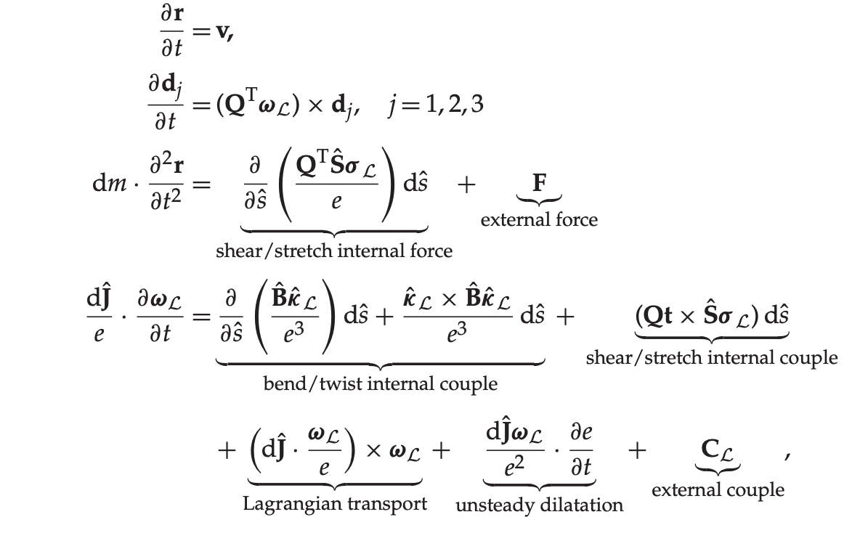
Mechanics of a Rod
M. B. Rubin, Cosserat Theories: Shells, Rods and Points

Slide 30
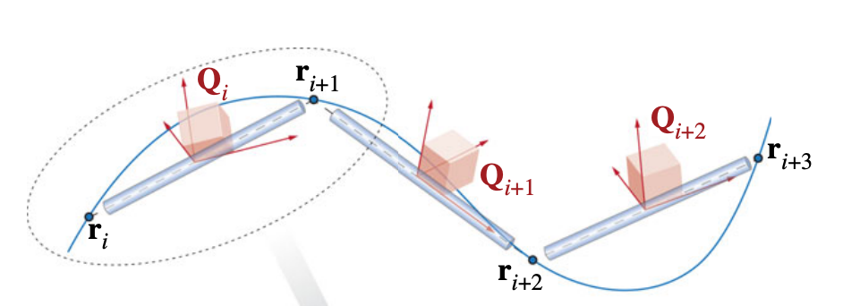
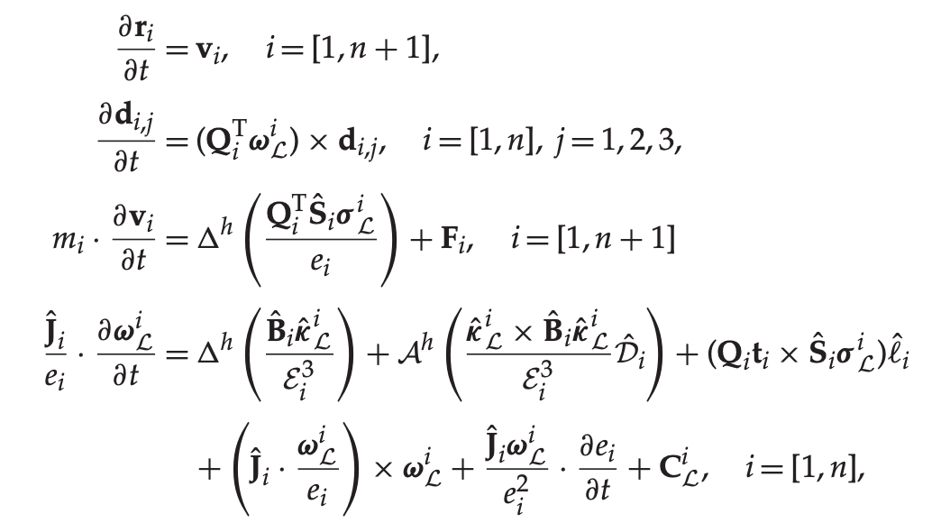
Mechanics of a Rod
M. B. Rubin, Cosserat Theories: Shells, Rods and Points

Slide 31
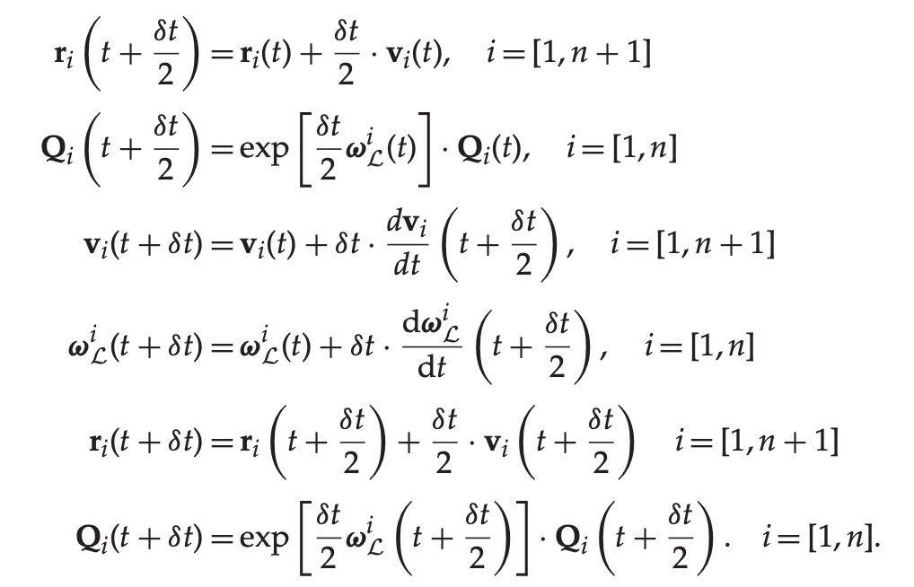
Time Integration (Symplectic, Verlet integrator)
M. B. Rubin, Cosserat Theories: Shells, Rods and Points

Slide 32
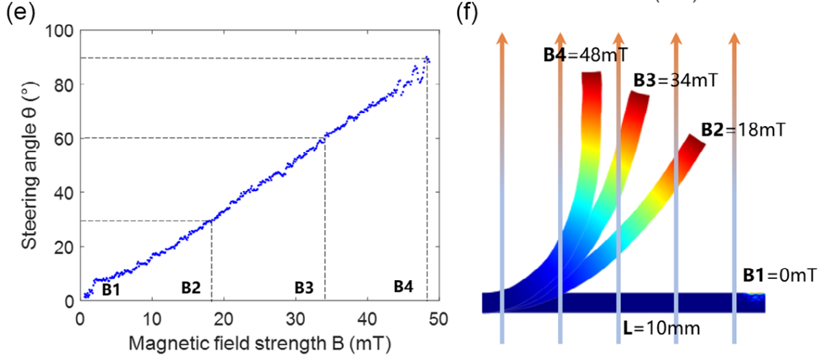
Outlook
Fu, S., Xu, T. et al. 2023

Slide 33
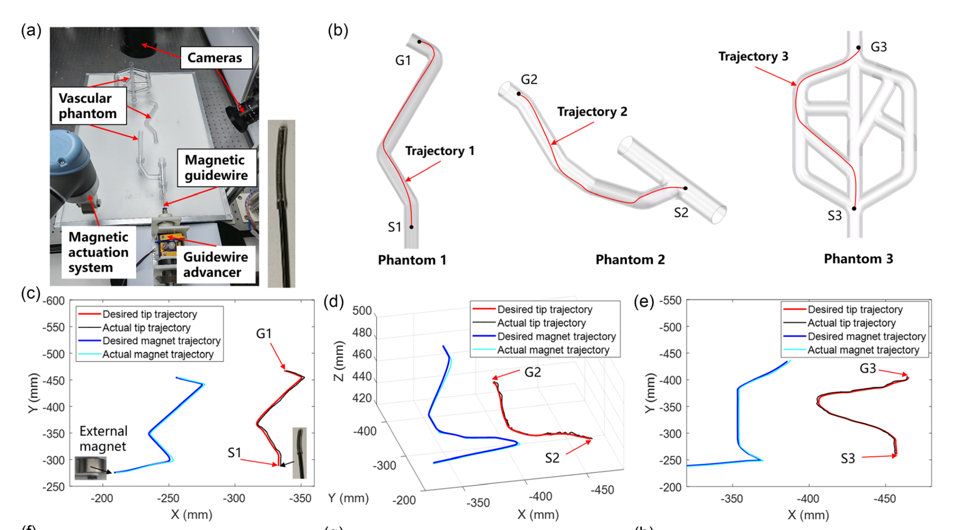
Outlook
Trajectory navigation
Fu, S., Xu, T. et al. 2023

Slide 34
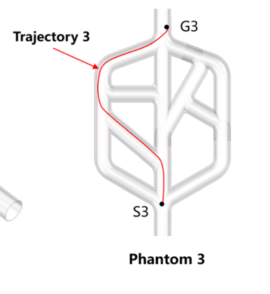
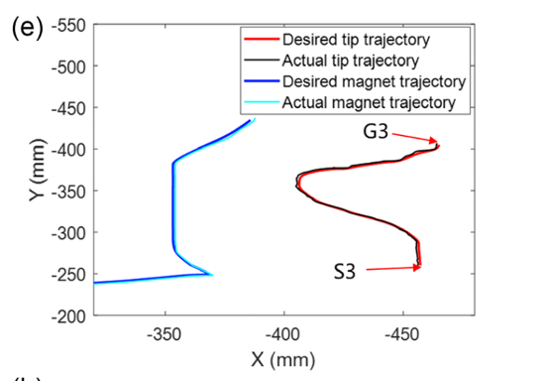
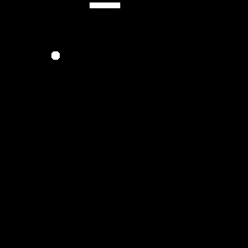
Outlook
The shake
Trajectory navigation

Slide 35
Remark
Three dimensional continua and one dimensional continua
The Lagrange coordinate
Mechanics of a Rod
Reproduction and ”the shake games”

Slide 36
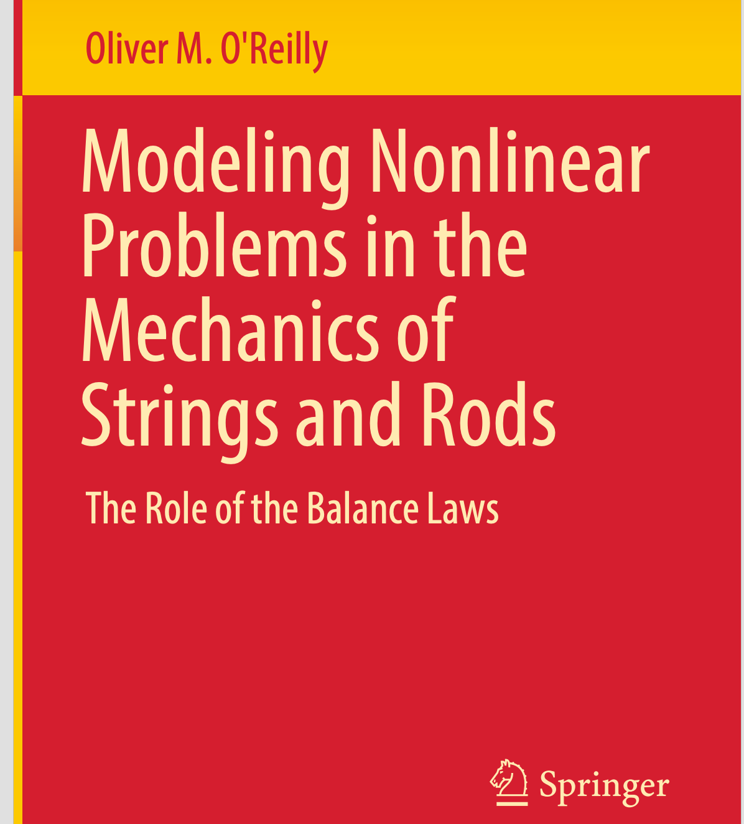
References
Modeling Nonlinear Problems in the Mechanics of Strings and Rods by Oliver M. O’Reilly
Cosserat Theories: Shells, Rods and Points by M.B. Rubin

